Slide 1
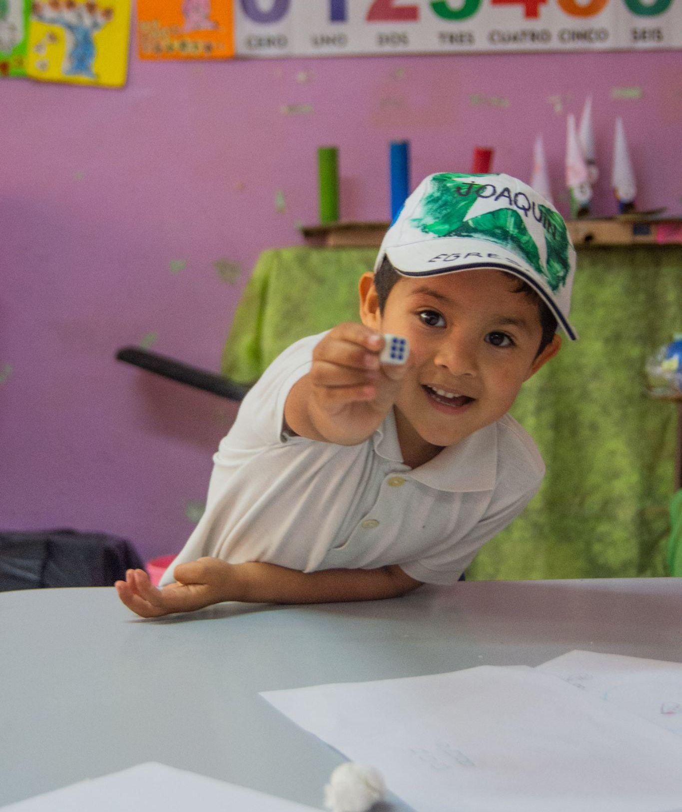
The Strengthening of Socio-educational Spaces for Children, Adolescents and Youth
González Catán, Buenos Aires, Argentina

Slide 2
About us
In Fundación La Salle Argentina, a non-profit organization founded in 1967 by the Brothers of the Christian Schools, we have the goal of building educational communities where children and youth are at the center. In the spirit of Lasallian education, we promote children’s and young people's rights through various proposals, mainly educational, that enable community development in contexts of social vulnerability and exclusion.
For more than 56 years, we have been carrying out different programs and projects implemented throughout the country, working with multiple governmental and non-governmental organizations, as well as national and international organizations, in order to transform the reality of our children and youth.

Slide 3
Our mission
Our main aim is to guarantee access to quality education, and we do so through many training spaces, such as: scholarship programs for children, young people and educators, teacher training, youth and adult training to enhance employment possibilities. We strengthen educational spaces through the development of new devices. It is within this framework that we present this project in articulation with the Armstrong Foundation School of González Catán. Based on this project, we seek to reduce the inequality gap in this community, allowing children and young people to access a quality education, in a space with the necessary conditions and resources to be able to do so.

Slide 4
Project location
This project is being developed in the Partido de la Matanza, specifically in the municipality of González Catán; one of the main socio-urban deficiencies of the Partido de la Matanza is the housing deficit. It’s a place of great infrastructural and social deficits. The possibility to access services, education and health centers is lower compared to other areas, being almost nil. Poverty rates are the highest in the district, reaching almost 80%. This region is geographically distant from the city of Buenos Aires and has the largest population in conditions of economic and social vulnerability; it’s also the largest region of the three as it can be seen on the map.
The space, where the Armstrong Foundation school is located, is open to the community and has green areas for the practice of sports, recreational and community activities, as well as buildings for the development of training, workshops and other support activities.

Slide 5
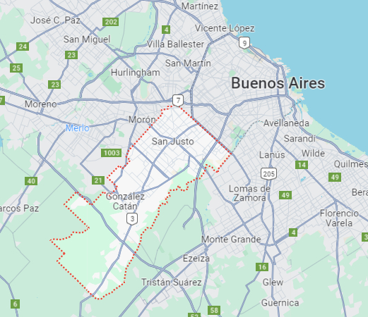
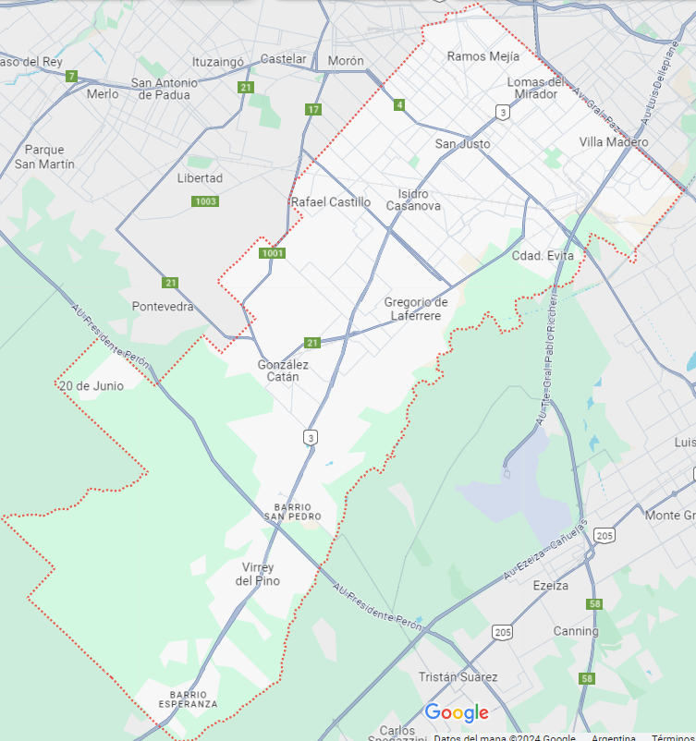
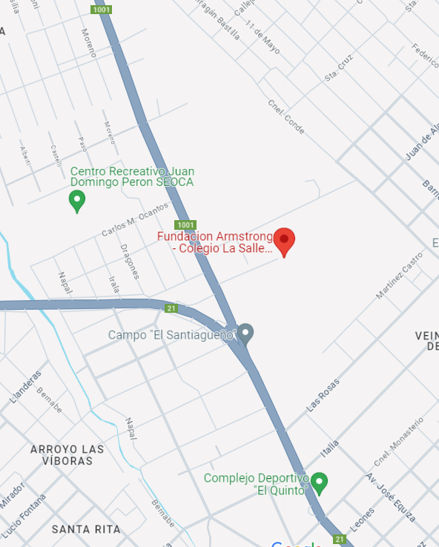
Project location

Slide 6
Who’s the aim of the project:
The more than 600 children, teenage girls and young students who go to the school in Catán and who are in a very vulnerable situation with difficulty to sustain their school work, that is often interrupted.
Indirectly, it will impact more than 2,400 people. The families of children, adolescents and young people, as they will nourish their families and close communities with the learning and tools they manage to incorporate for their educational paths, allowing the family, community and social ties to be strengthened.

Slide 7
Objective
The goal of this project is to achieve the strengthening of 2 school spaces at González Catán, which include building renovation and the creation of new devices for NNYA’s socio-educational follow-up.

Slide 8
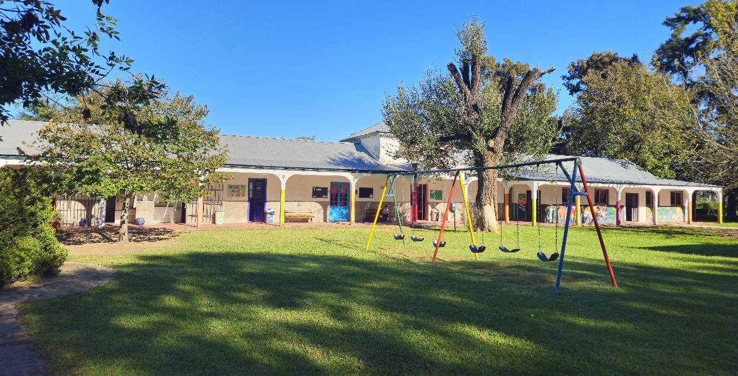
Our proposal
1. The renovation of buildings and the purchase of equipment for the Complementary Education Center that works with early childhood and children up to 12 years of age, focused on strengthening educational paths: work in school literacy, school support, as well as strengthening the recreational relationship between children and families.

Slide 9
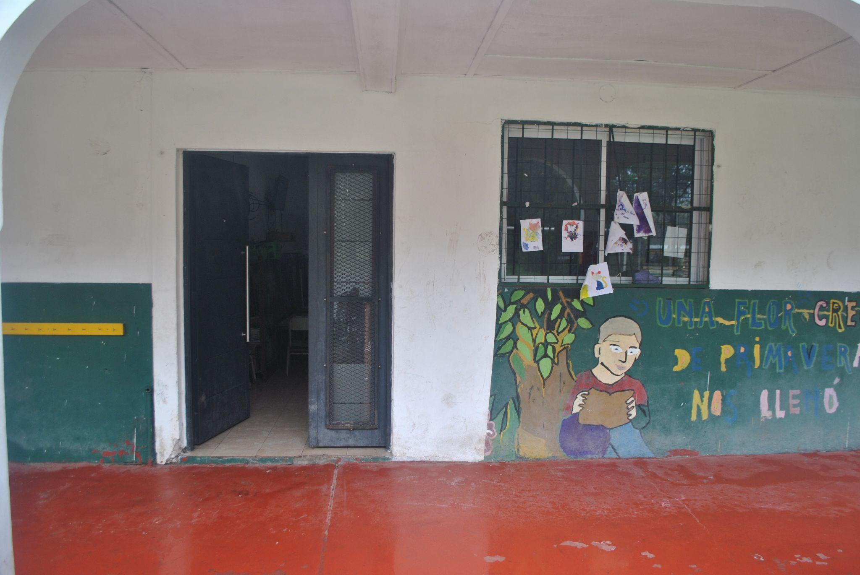
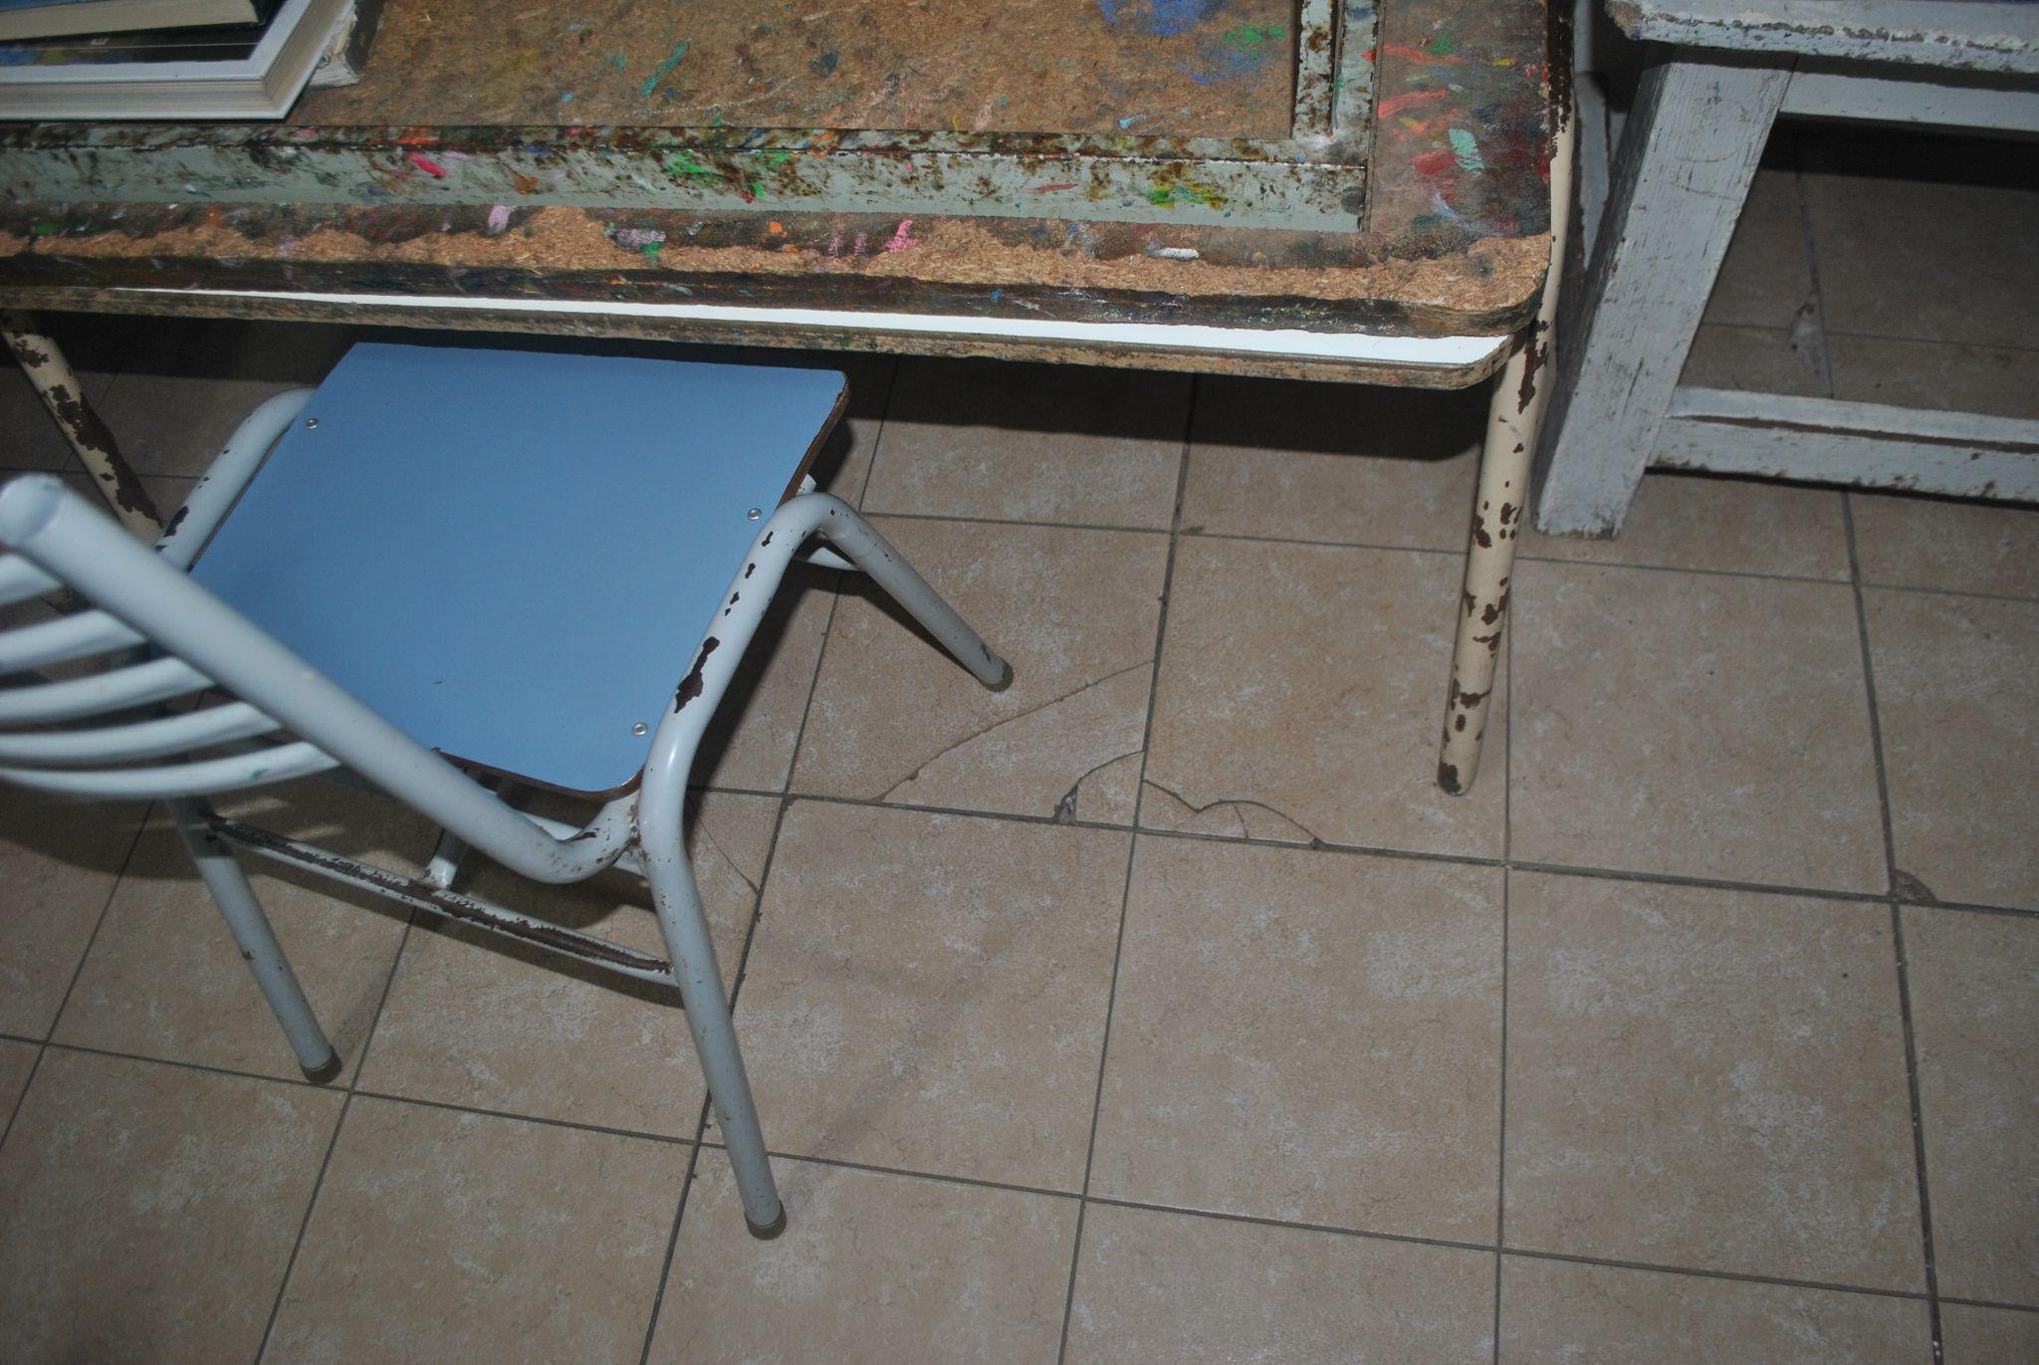
Pictures of how the Complementary Education Center looks like today.

Slide 10
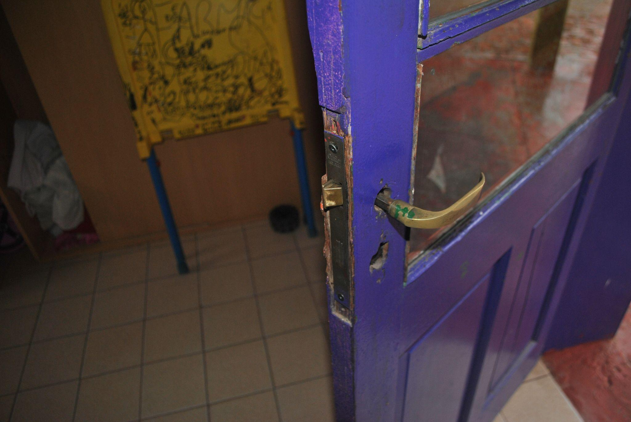
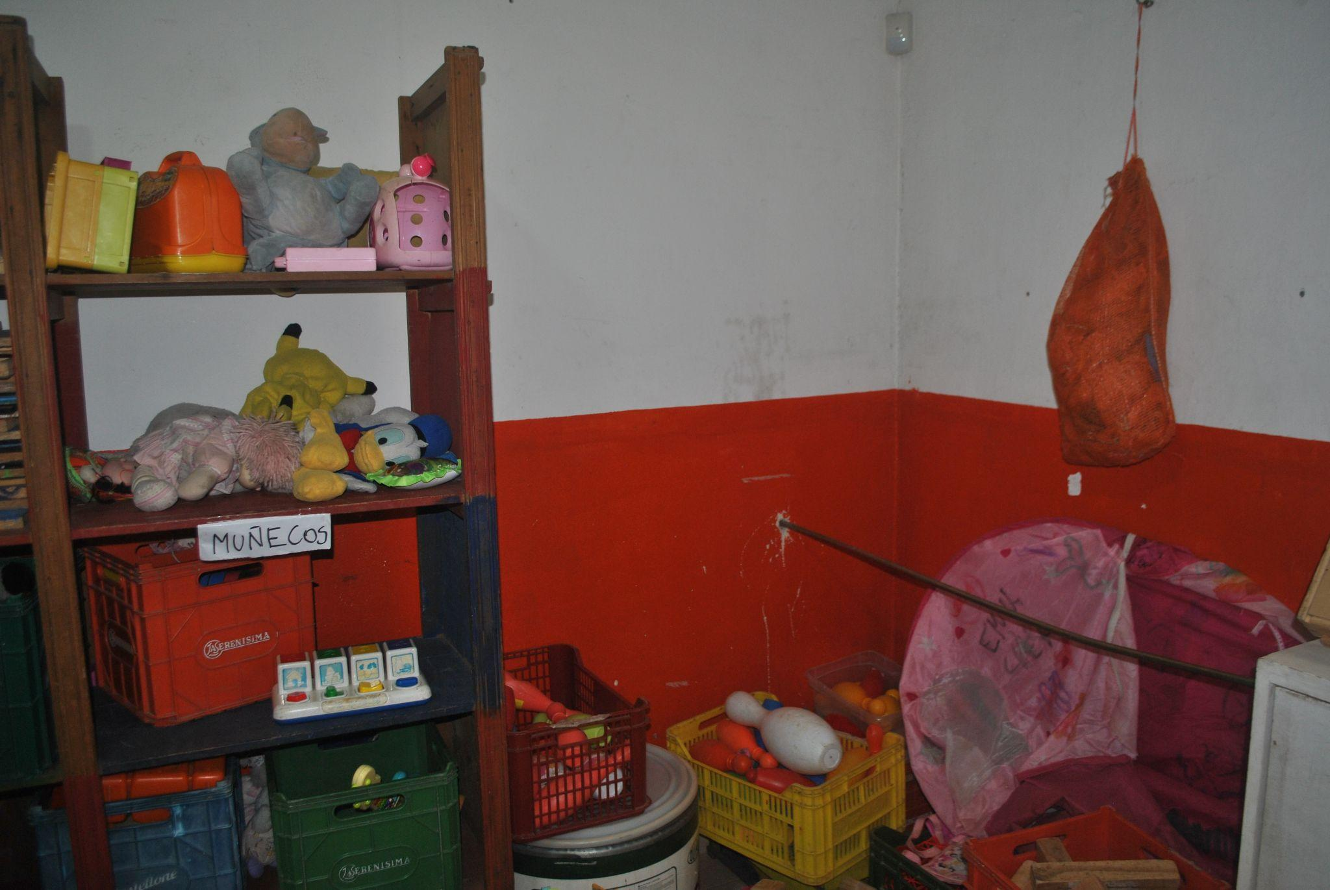

Slide 11
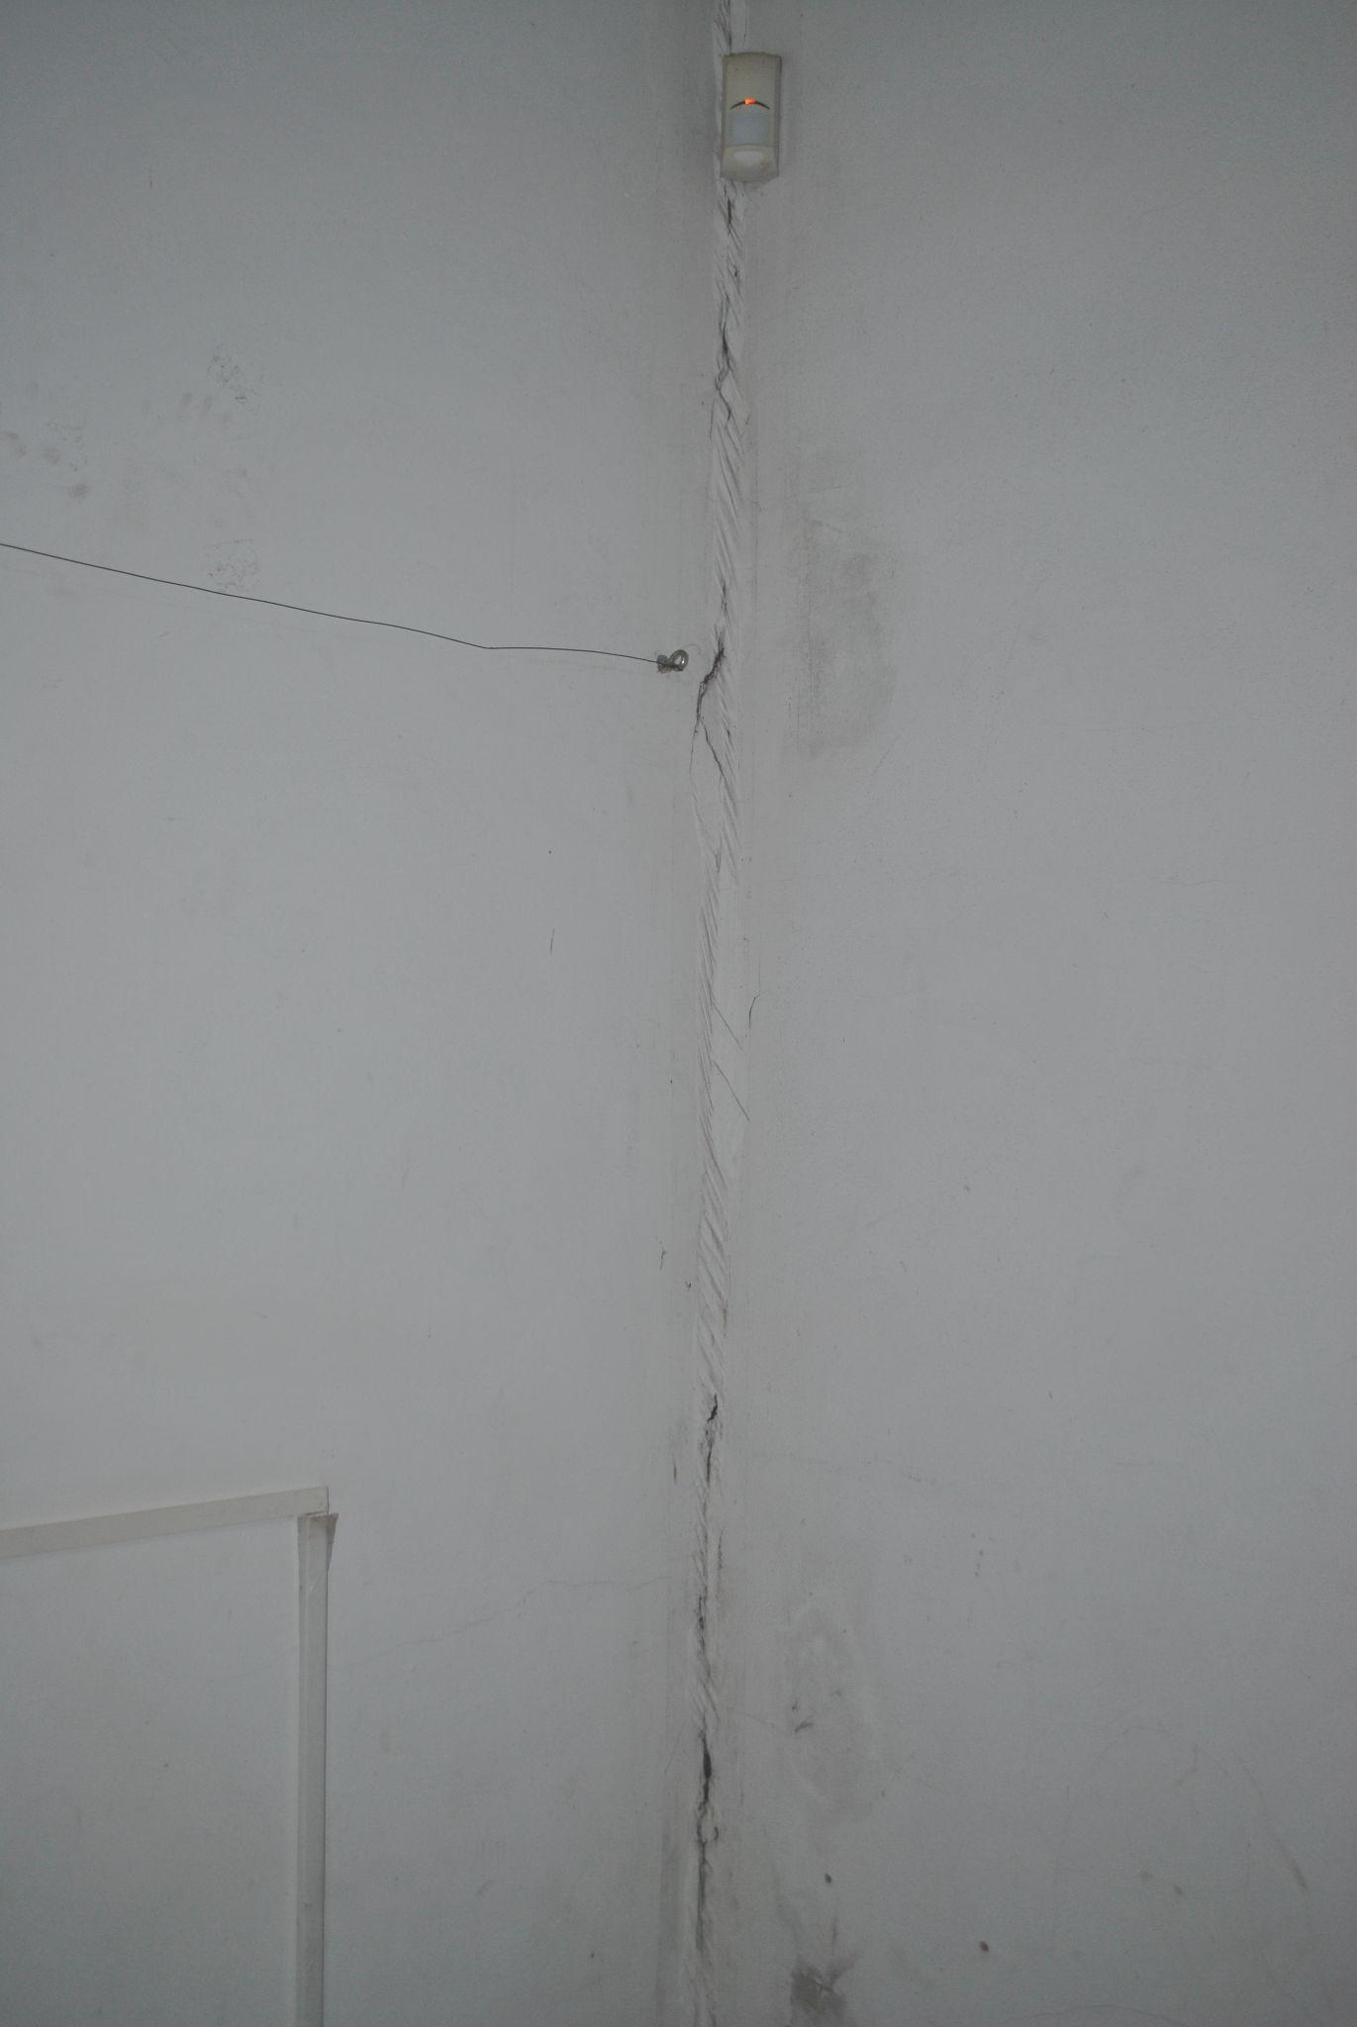

Slide 12
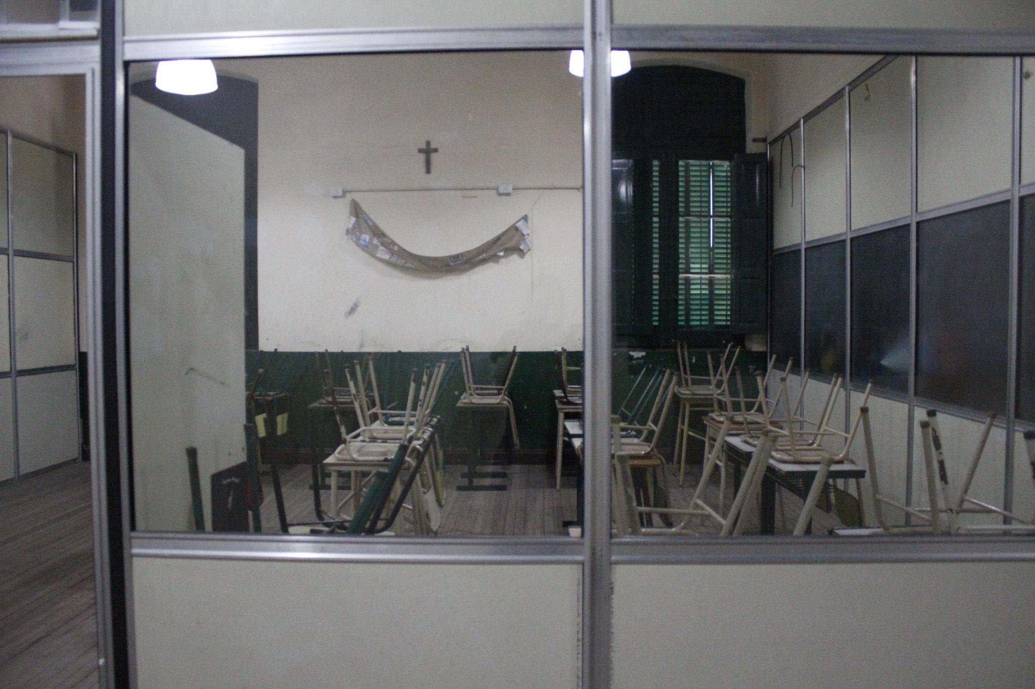
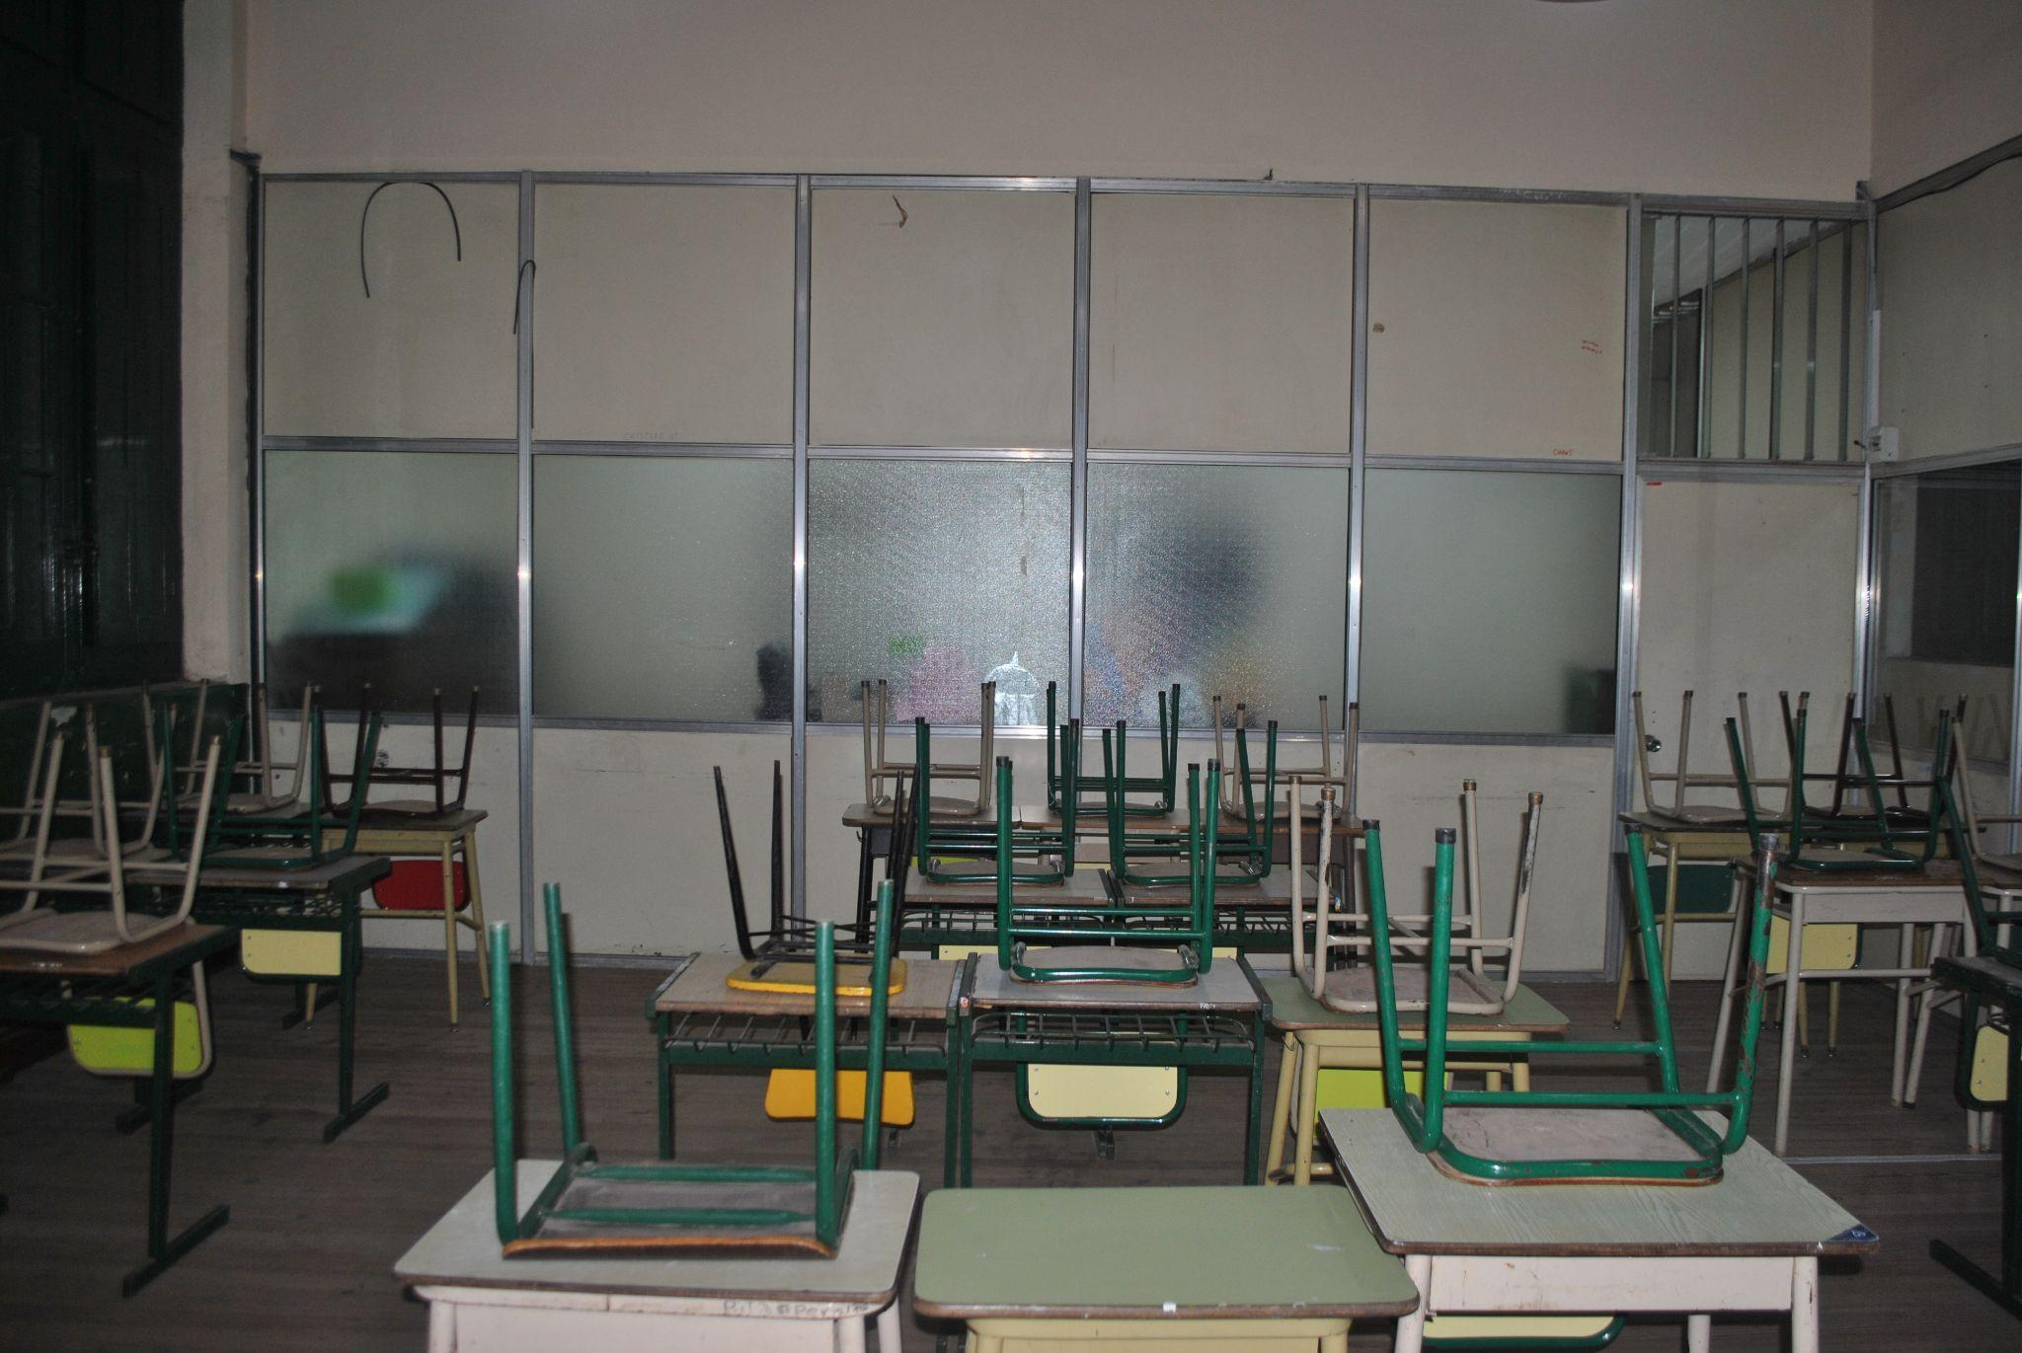
2° Space to intervene: Pictures of how the high school building looks like today

Slide 13
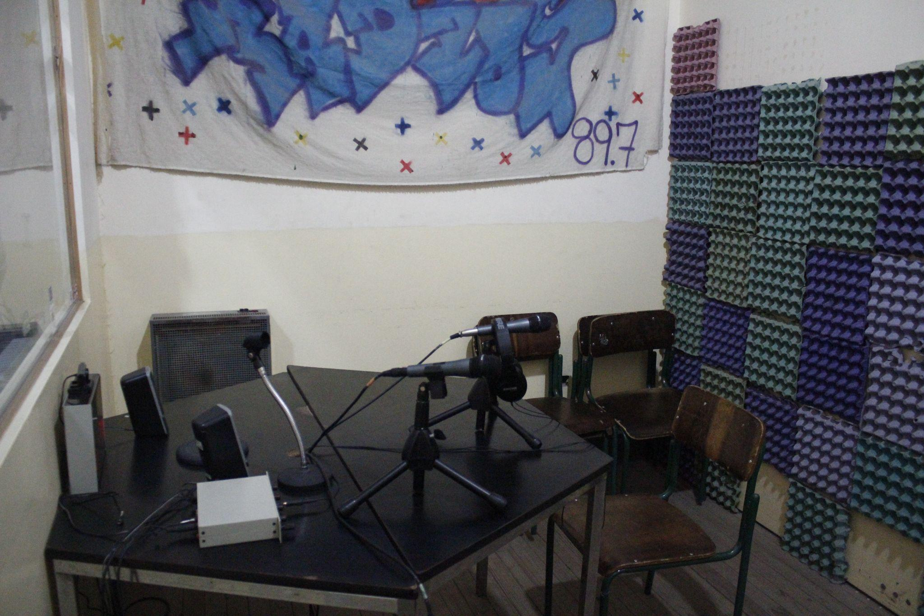
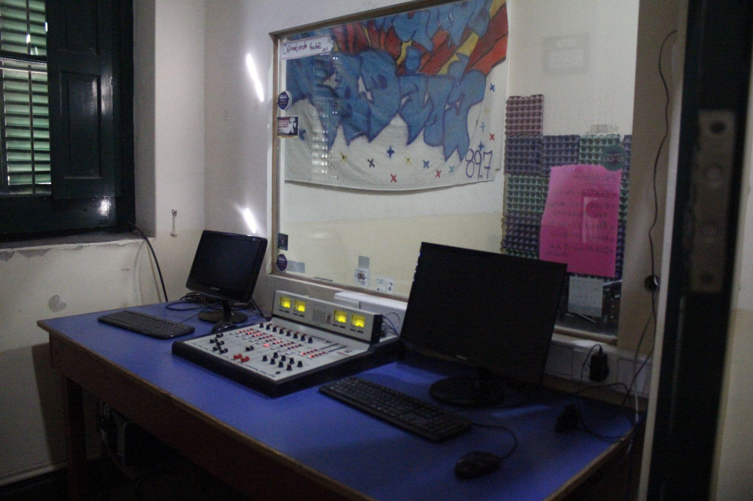

Slide 14
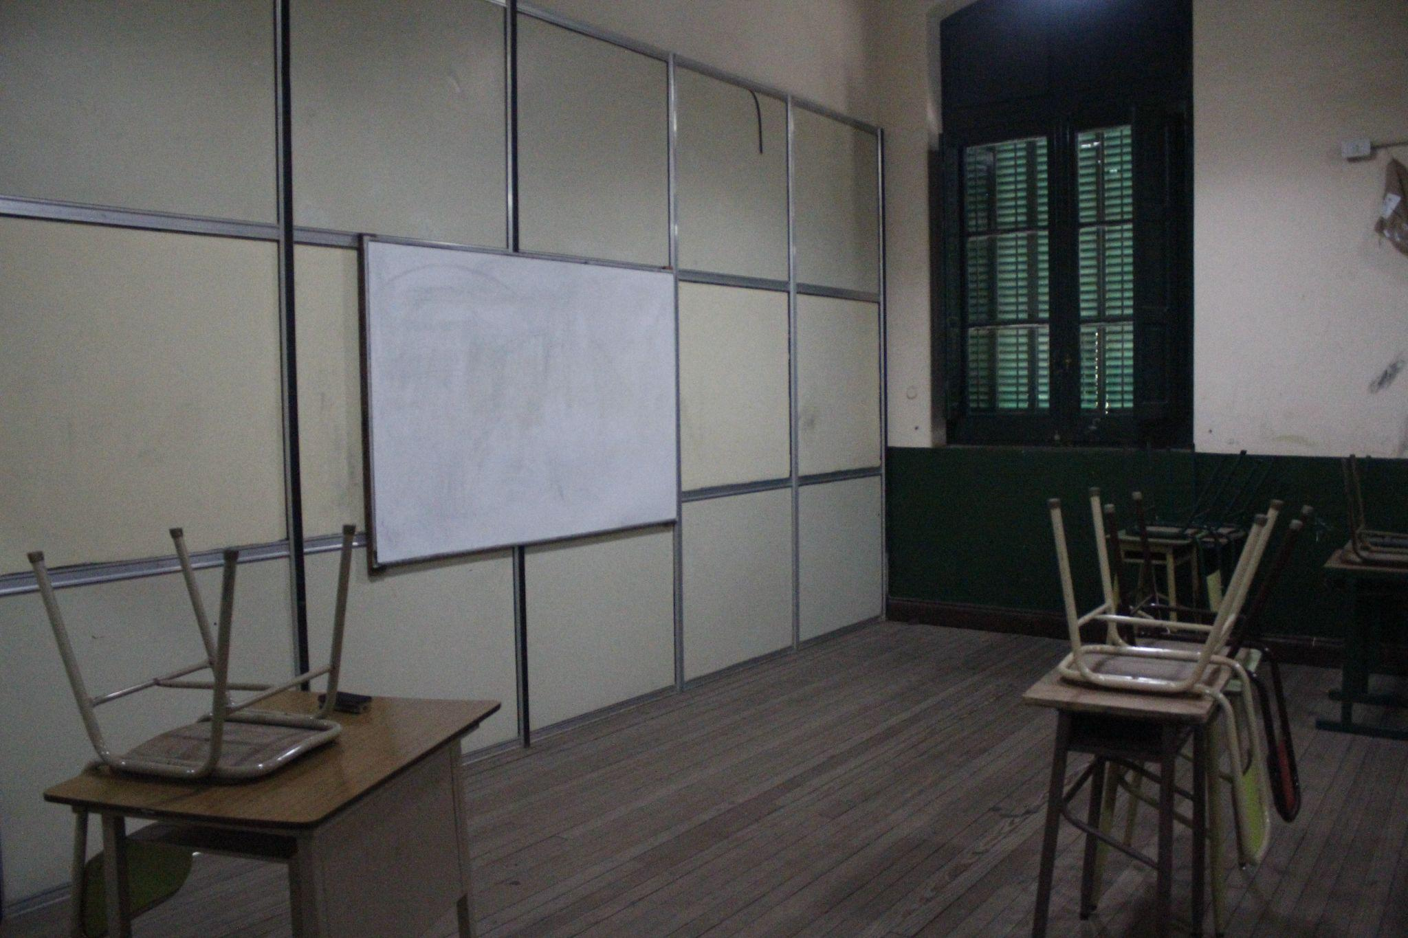
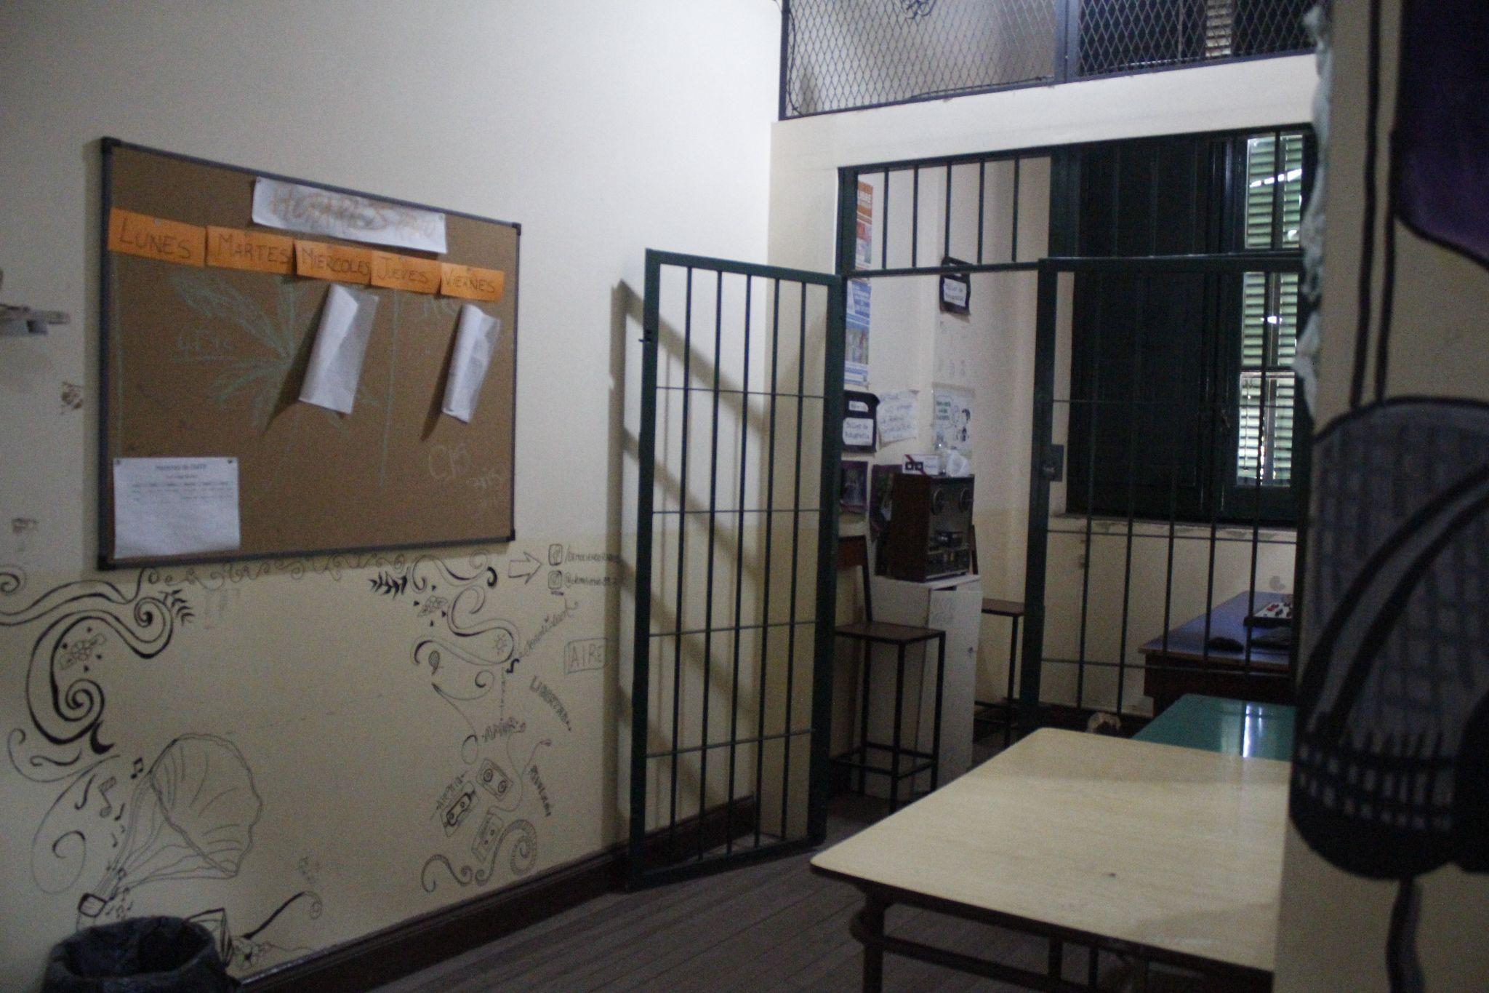

Slide 15
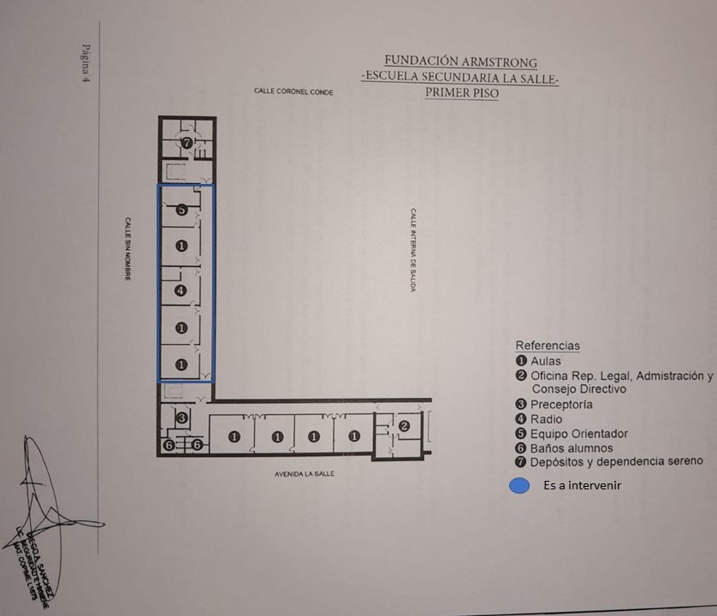
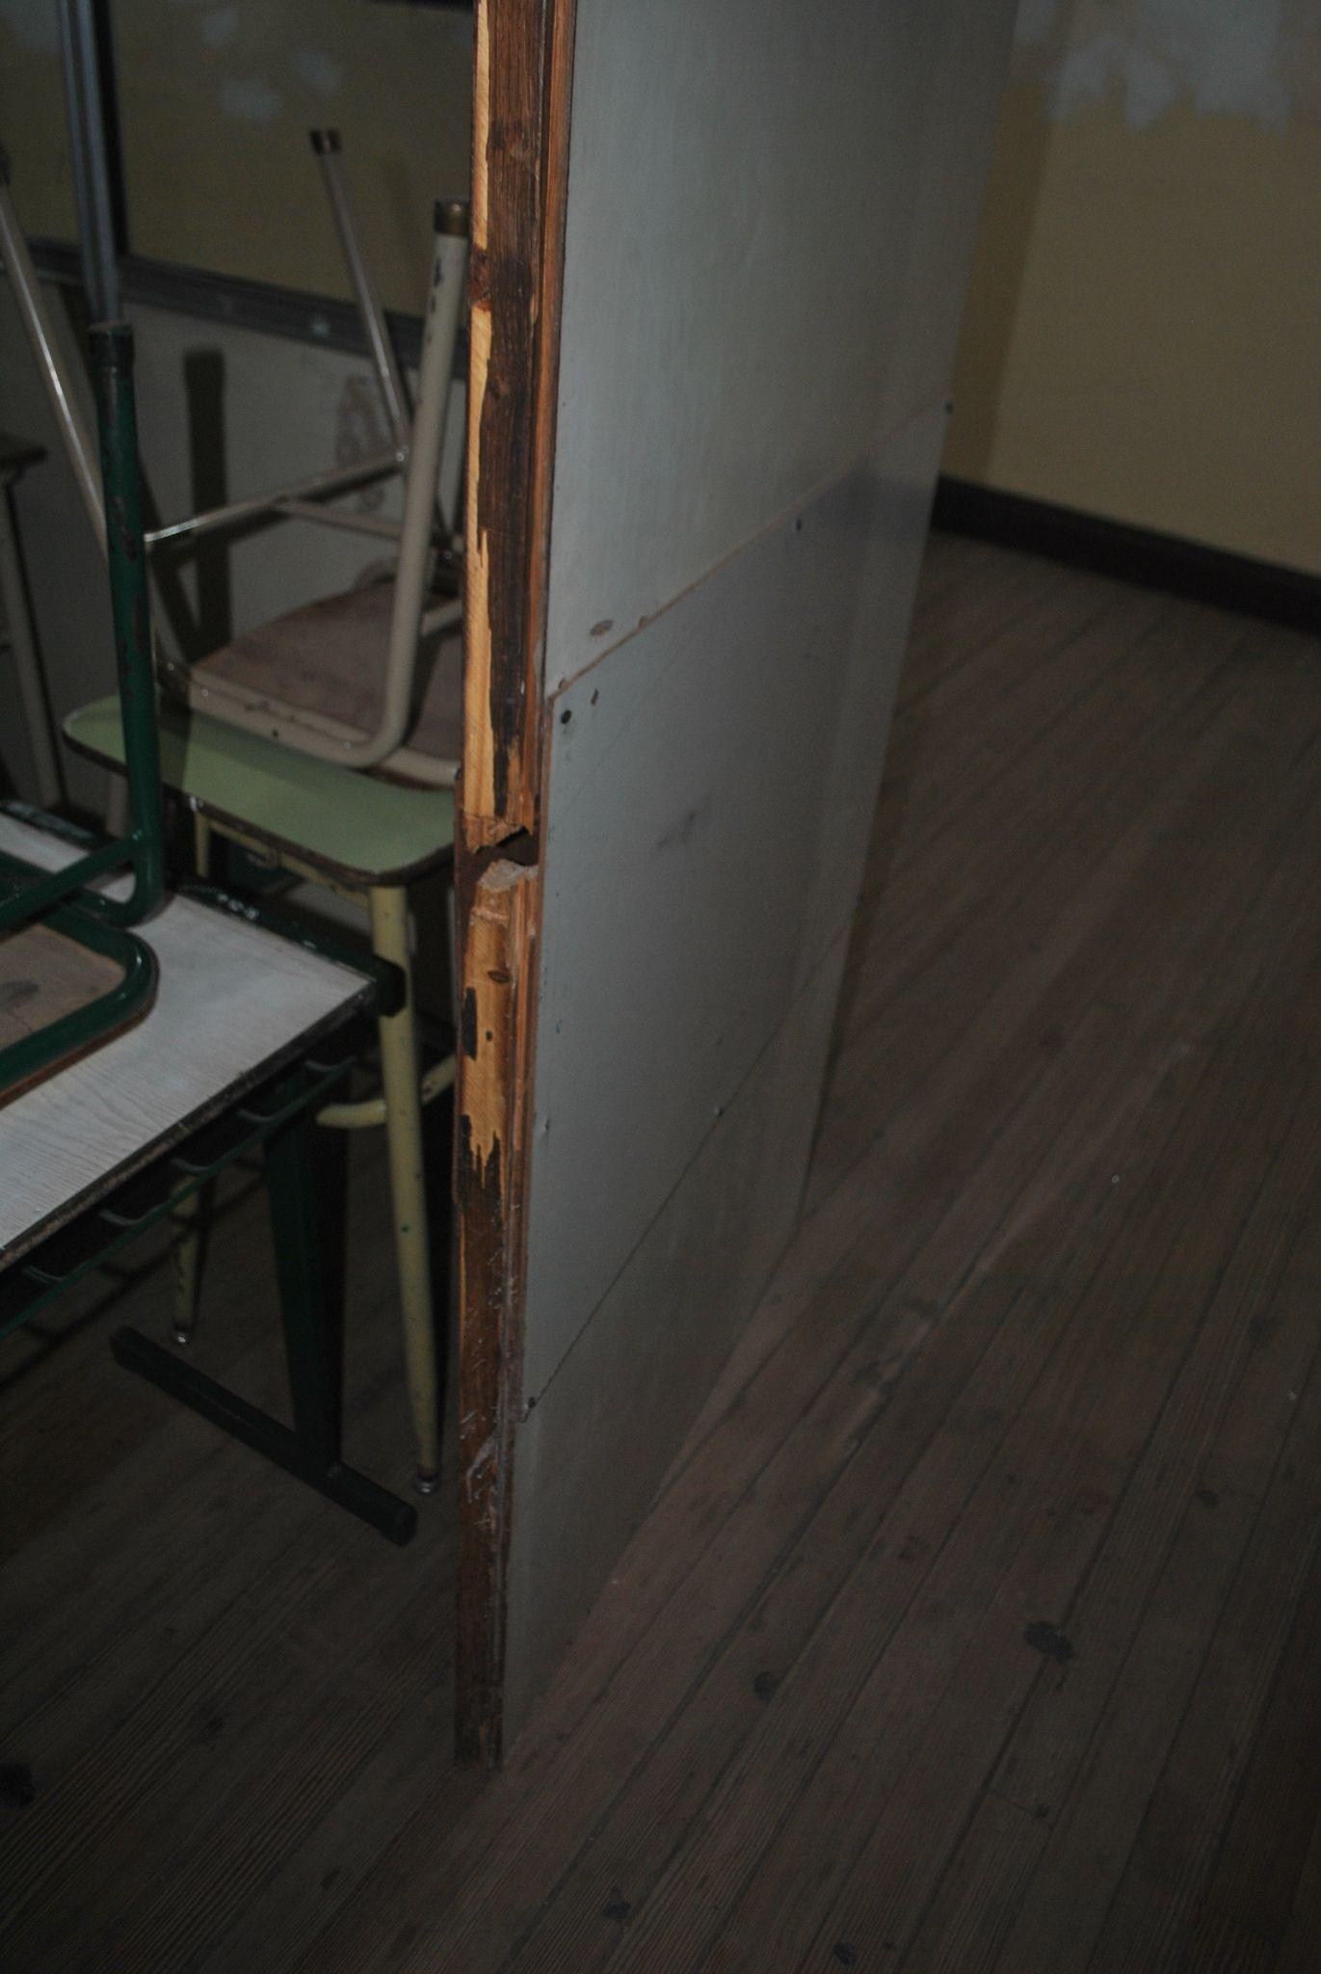

Slide 16
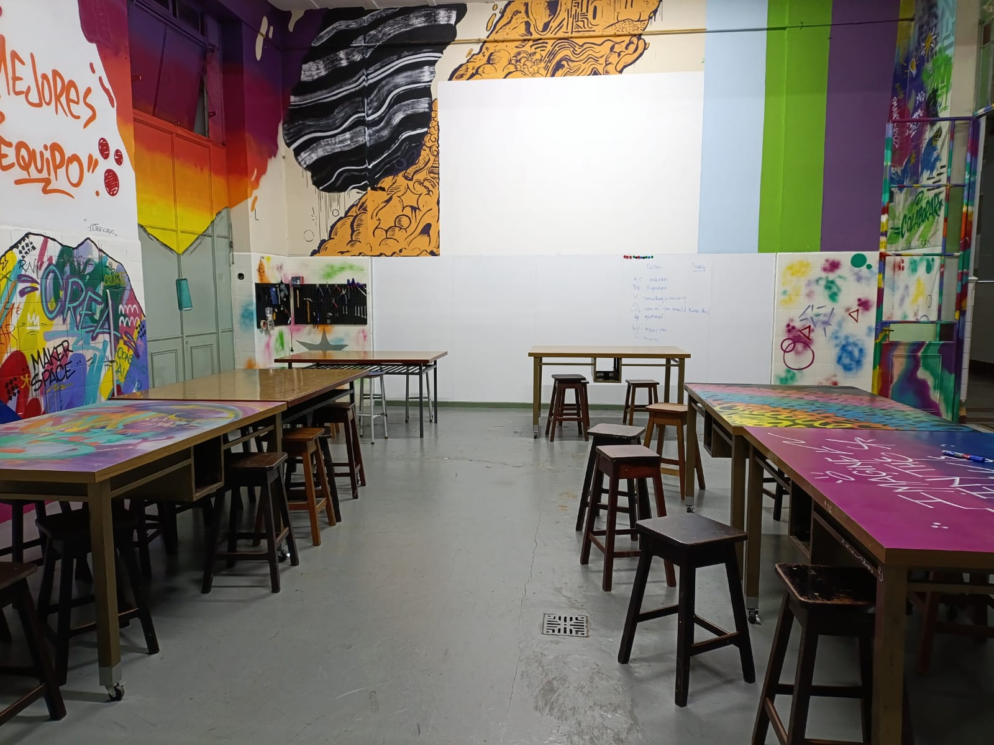
Our proposal
2. The building renovation and equipment for the creation of a new makerspace device
What is a Makerspace?
It is the place where students have the freedom to design, create and modify their own product. These productions may be physical (cardboard, plastic, paper, etc.), digital (audio, video, image) or combined.
It is a flexible space with a variety of resources that favours different types of educational actions:

Slide 17
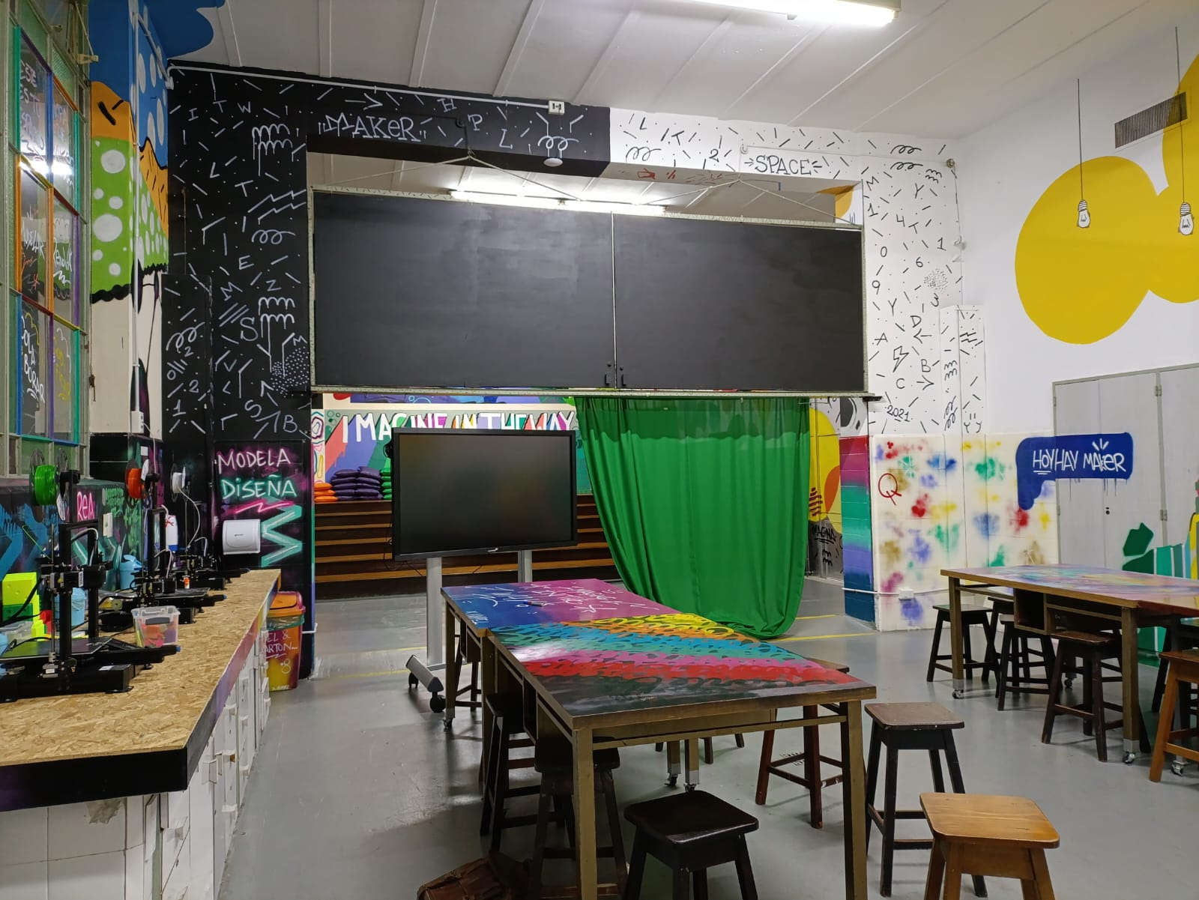
Working as a team or individually, sitting on benches or at work tables, working standing up, on tables or walls, moving around space, etc.
Research, cut, paste, paint, embed, design, print, present, listen, write, record, edit, program, test, explore, experiment, etc.
It stimulates interdisciplinary projects where they work flexibly and collaboratively, carrying out different activities and productions in a succession of planned stages.

Slide 18
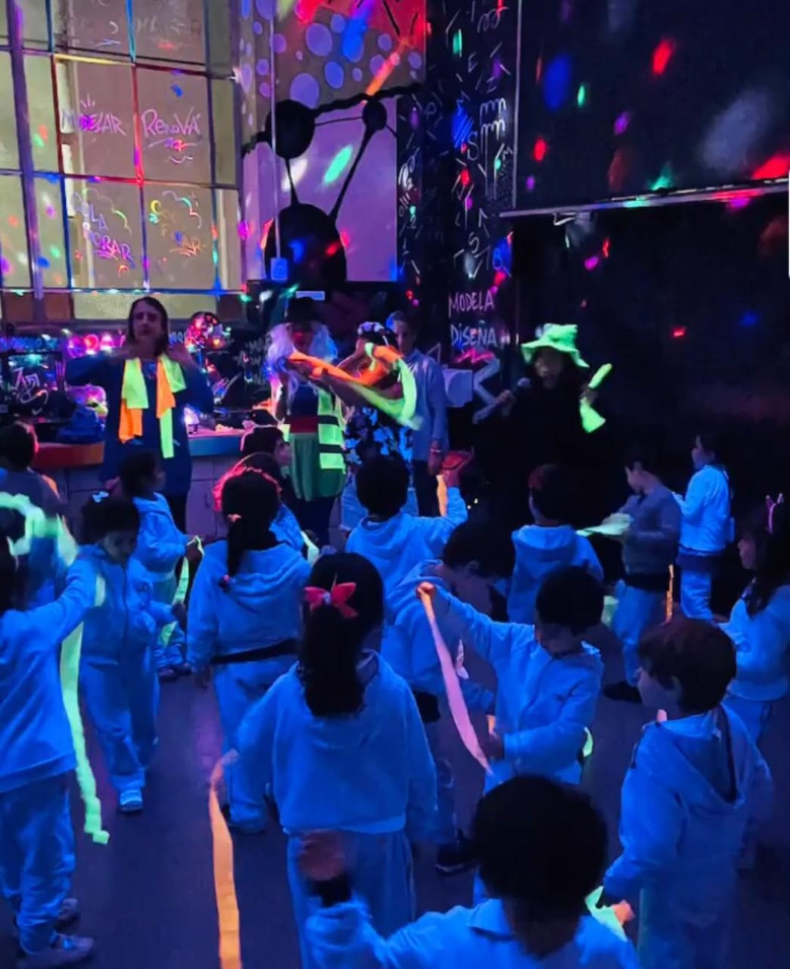
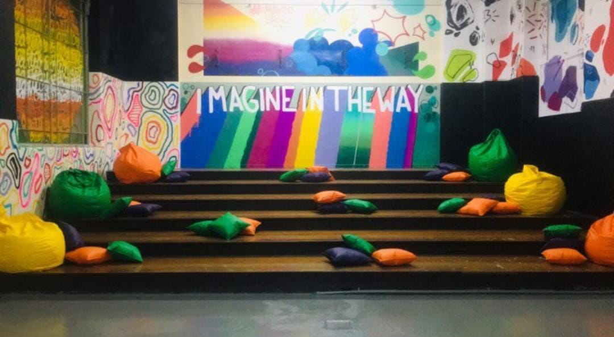
What happens in a Makerspace?
The construction that takes place in a Makerspace generates conditions for collaboration and exchange between peers and is guided by the search for original ideas and new ways of learning.

Slide 19
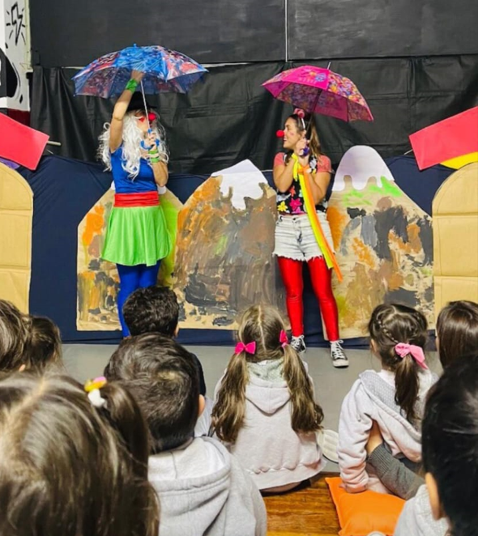
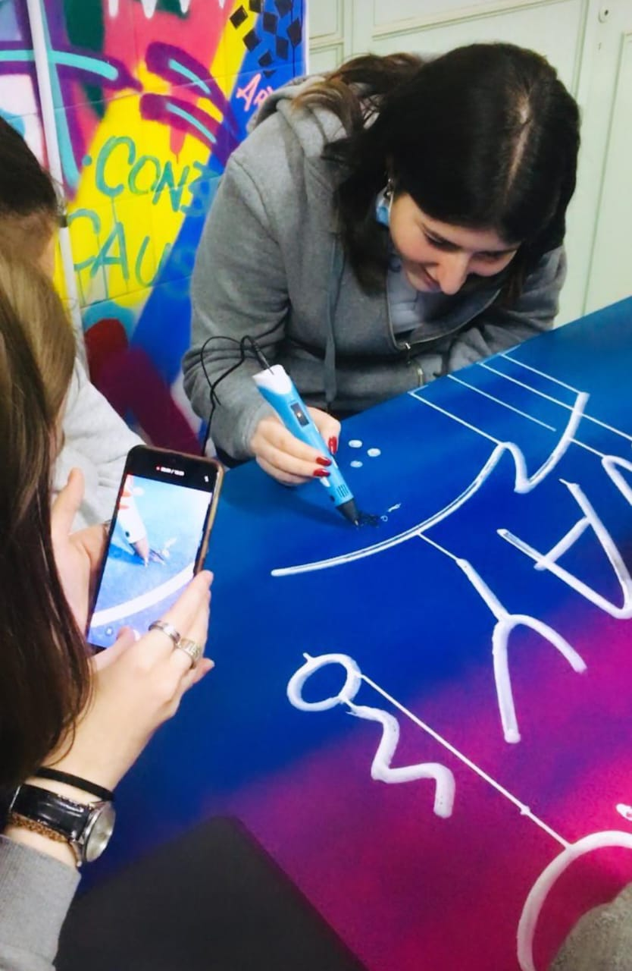
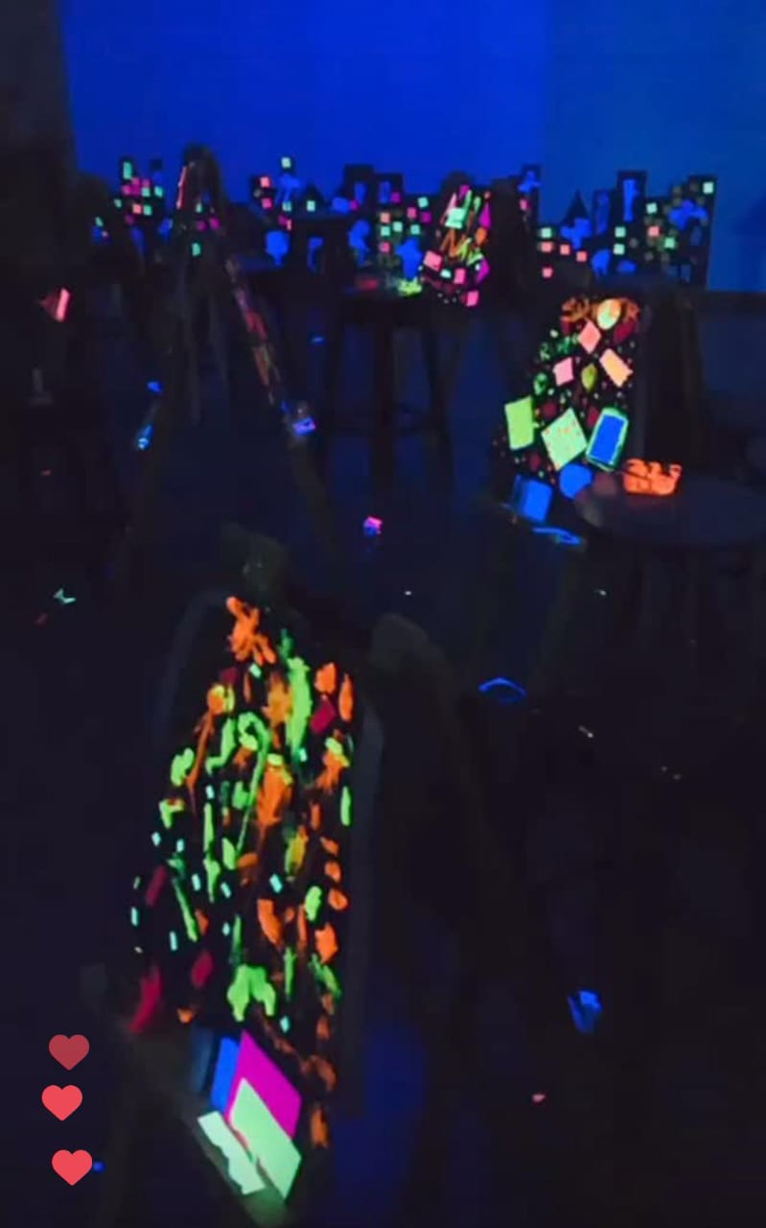

Slide 20
Budget and work modality
Building renovation: CEC Space and Makerspace
Description | Budget | Suppliers
Renovation of floors, doors, ceilings, painting; furniture acquisition | USD 70.000 | We work combined with architecture studios that guarantee: Designs and work planning, request for permits from regulatory entities, hiring of personnel, purchase of materials, insurance and execution of work. BCRS Architects FT Architects In addition, government agencies conduct annual inspections and certify that building conditions are safe. *A market offer analysis is carried out for each project looking for the most competitive offer on the market.

Slide 21
2. Teaching materials
Description | Budget | Suppliers
Digital teaching material: 4k short throw projector, radio console, microphones, cables, microphone stands, sound insulation boards, printer, 3D printer, sound (powered speakers, console), 4 tablets and 1 laptop. Analog teaching material: games, stimulation toys, soft squares | USD 30.000 | For technological equipment we work with the importing company “SOL 2000 computación” who has more than 20 years of experience in the field and provides quality equipment, with a guarantee and at competitive market prices. For equipment and teaching materials we do not have a loyal supplier since we look for the best market offer for each project. *A market offer analysis is carried out for each project looking for the most competitive offer on the market.
Total project amount: USD 100,000

Slide 22
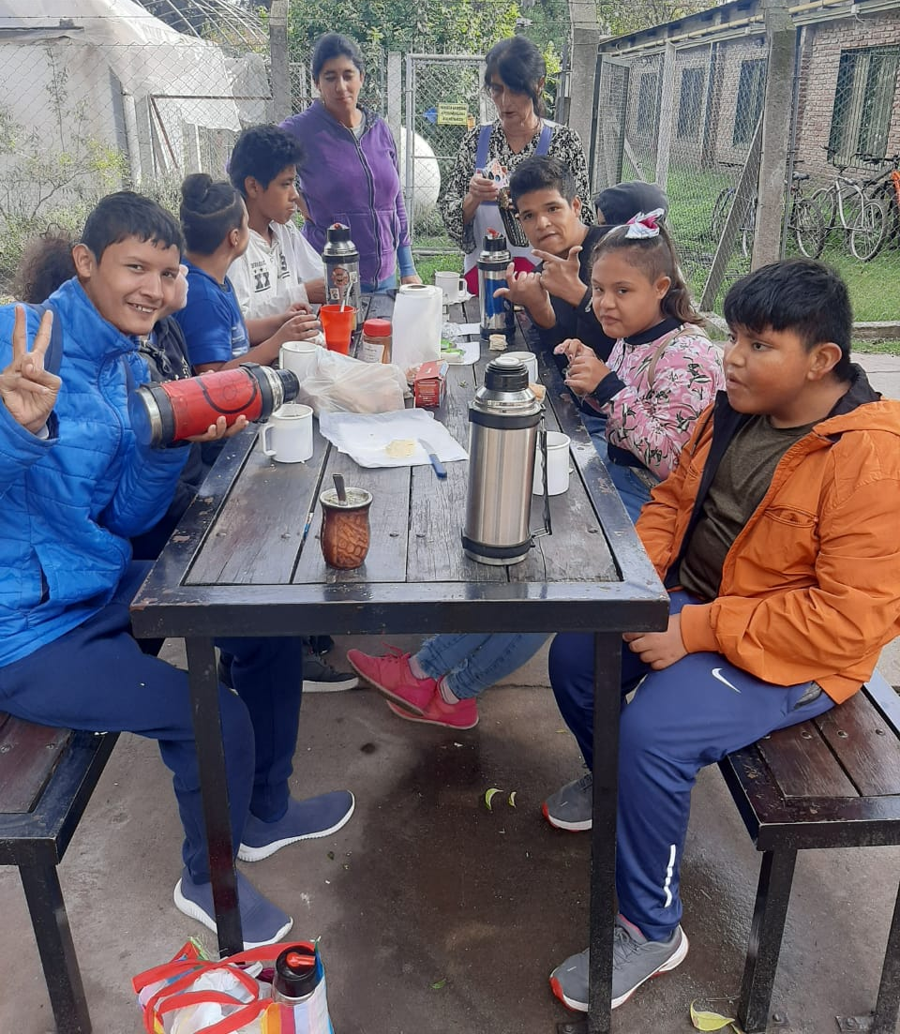
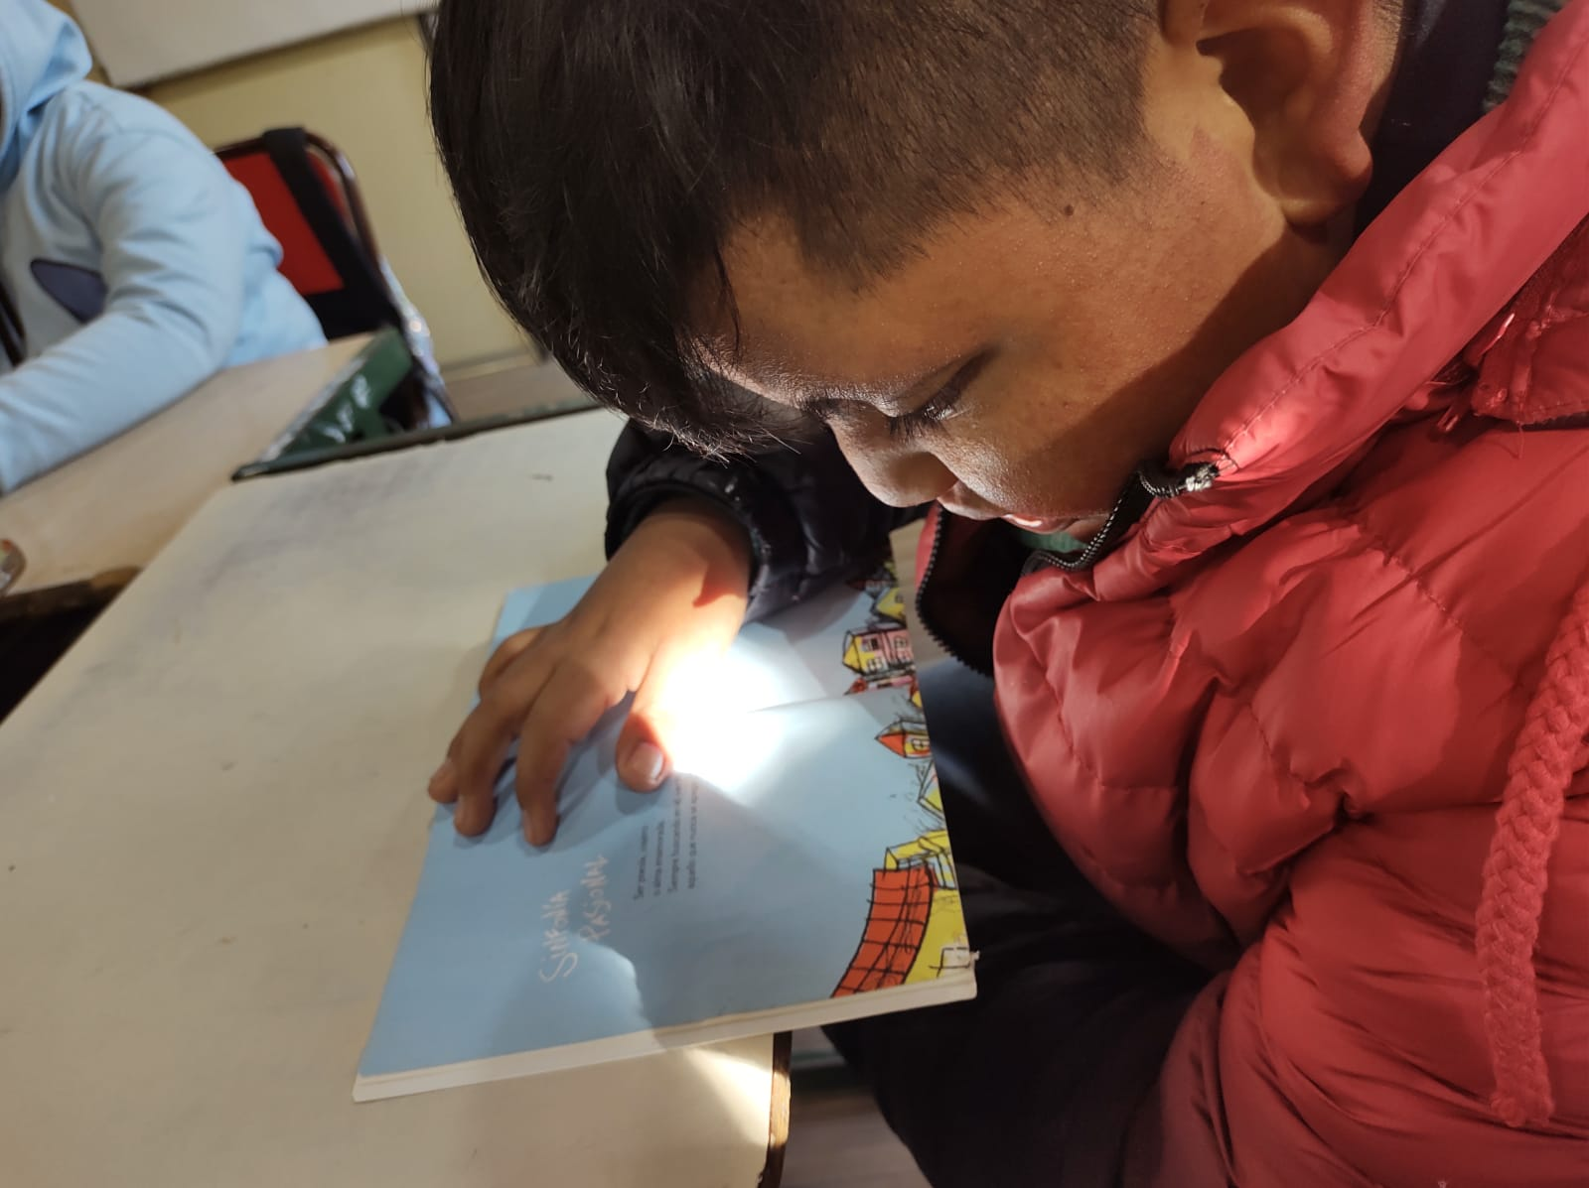
Community service
Work with disabled students

Slide 23
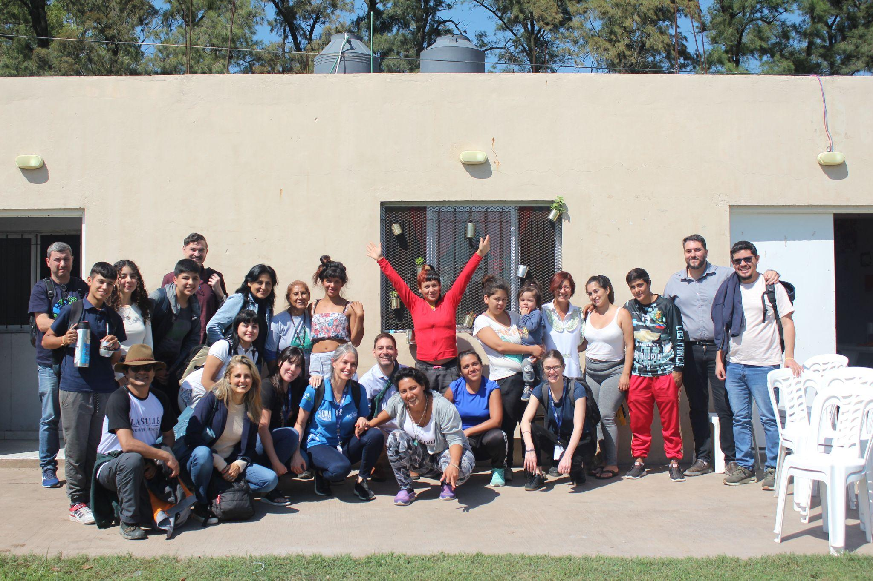
Community service
2. “Home of Christ”
(work with problems addictions)

Slide 24
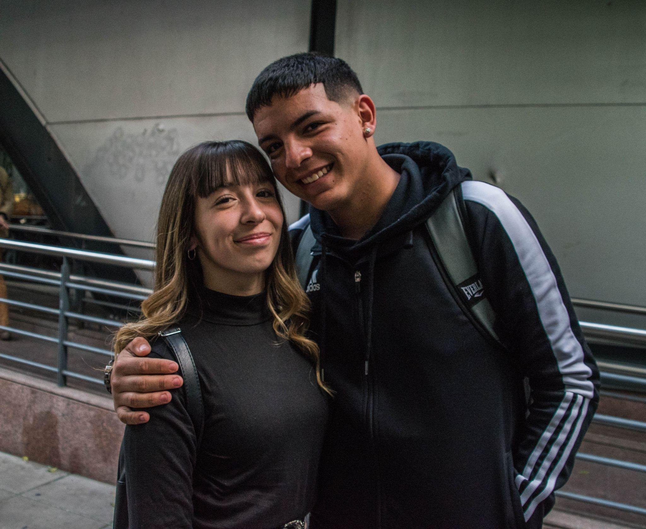
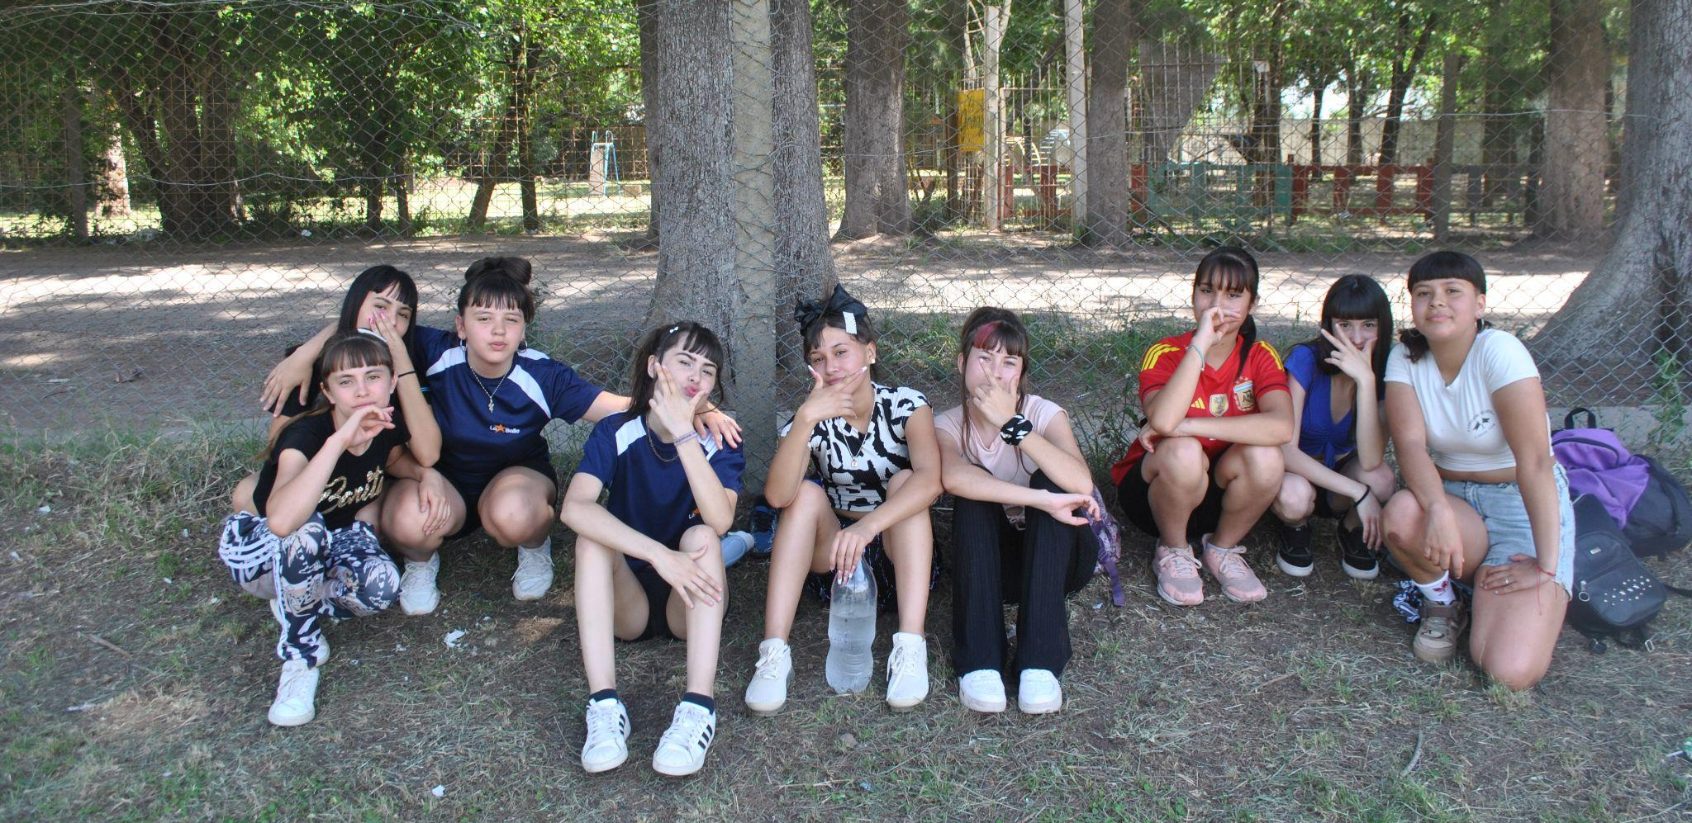
Community service
3. “Envión” device ( Work with youth in situations of social vulnerability)

Slide 25
Thank you!

